Slide 1
Network PD
November 2014

Slide 2
Agenda
PD Topics by Month
“What You Need to Do Now”
DESE Survey Highlights
BPS.org refresh (FAQ availability, resources, etc.)
PARCC Contact List Availability
PARCC Support Model
Available Resources Now (e.g. practice tests)
Survey Request and Q&A

Slide 3
Network PD Topics (1/2)
MONTH | TOPIC | Sub-topics
DECEMBER | Performance Based Assessment vs. End of Year Assessment | By grade: Who takes? (e.g. G3 only takes XY while G10 takes XYZ) Length Differences between ELA & Math for PBA vs. EOY Skills assessed in each exam Question structure Suggested strategies/resources to utilize Scheduling considerations
JANUARY | “What you need to do now for the PBA Assessment” | Practice questions and tests Technology set-up (e.g. roster uploads) Review accessibility and accommodations features
FEBRUARY | ”Finish Line” PBA Assessment Checklist | Practice questions and tests Review Paper/Pencil vs. Online protocols Review accessibility and accommodations features Dry-run test administration Review student registrations and technology

Slide 4
Network PD Topics (2/2)
MONTH | TOPIC | Sub-topics
MARCH | “What you need to do now for the EOY Assessment” | Practice questions Technology set-up (e.g. roster uploads) Review accessibility and accommodations features
APRIL | PBA Lessons Learned + EOY Planning | PBA Lessons Learned EOY Planning
MAY | “Finish Line” EOY Assessment Checklist | Practice questions and tests Review Paper/Pencil vs. Online protocols Review accessibility and accommodations features Dry-run test administration Review student registrations and technology
JUNE | EOY Lessons Learned | EOY Lessons Learned

Slide 5
Network PD Schedule Summary
MONTH | TOPIC | Sub-topics
NOVEMBER | PD Roadmap and Resources | This session will be used to explain the upcoming events and resources available for parents , teachers, and students to prepare for PARCC
DECEMBER | Performance Based Assessment vs. End of Year Assessment | This session will be used to explain the key difference for each exam. In addition, we will use this time to discuss format, content, and strategies for each exam
JANUARY | “What you need to do now for the PBA Assessment” | This session will cover the activities that should be completed now to prepare for the PBA Assessment
FEBRUARY | ”Finish Line” PBA Assessment Checklist | This session will cover all remaining activities needed for the PBA assessment
MARCH | “What you need to do now for the EOY Assessment” | This session will cover the activities that should be completed now to prepare for the EOY Assessment
APRIL | PBA Lessons Learned + EOY Planning | This session will cover lessons learned from the PBA assessment and to begin preparing schools for the EOY assessment.
MAY | “Finish Line” EOY Assessment Checklist | This session will cover all remaining activities needed for the EOY assessment
JUNE | EOY Lessons Learned | This session will cover lessons learned from the EOY assessment

Slide 6
Agenda
PD Topics by Month
“What You Need to Do Now”
DESE Survey Highlights
BPS.org refresh (FAQ availability, resources, etc.)
PARCC Contact List Availability
PARCC Support Model
Available Resources and Future Plans
Survey Request and Q&A

Slide 7
“What You Need To Do Now”
(we have a handout with these websites)
School-Wide Edition
Identify testing sites (e.g. classrooms) and test schedule
Obtain accommodation devices (e.g. headphones – see last bullet for list of accessibility and accommodations required for PARCC)
Encourage technology usage in the classroom (e.g. typing, answering questions, reading, etc.)
Review DESE PARCC page on Technology Skills for Online Assessments that students need to obtain
Continue to teach the Massachusetts Curriculum Frameworks
Take a practice test on PARCConline.org
Review sample PARCC questions by grade level
Review BPS’ Educator Resources page
Review DESE PARCC page
Review DESE page on Accessibility/ Accommodations

Slide 8
“What You Need To Do Now”
Teacher Edition
Take a practice test on PARCConline.org
Review sample PARCC questions by grade level
As often as possible, use technology for homework
Review DESE PARCC page on Technology Skills for Online Assessments that students need to obtain
Continue to teach to the standards and shifts in content and curriculum
Remember: the goals of our standards and PARCC are college and career readiness
Begin to identify the great things you are already doing to prepare students for the types of thinking and practices that will be addressed on PARCC
Begin to identify where you would like more resources and support

Slide 9
“What You Need To Do Now”
Student Edition
Take a practice test on PARCConline.org
Review sample PARCC questions by grade level
As often as possible, use technology for homework

Slide 10
Key Messages
Teachers need to be:
Teaching to the standards
Teaching to the scoping plan developed by the district
These scope and sequencing plans are on Aspen/SIS, were updated in the summer. Teachers should not be using scoping plans from previous years.
Review the monthly plan passed out
We cannot address all questions now, but have a plan in place to answer them throughout the year
We will intro many topics today, but will dive deeper over the year (specifically the next three months)

Slide 11
PARCC will assess Key Shifts in Mathematics Standards
Focuses on fewer standards per grade:
each standard addressed more deeply
coherent progression across grades
Conceptual understanding of topics is foundational.
Students are expected to apply and extend their knowledge to real-life modeling and problem solving.
At the high school level, PARCC will be an end of course test.

Slide 12
PARCC will assess Key Shifts in ELA/Literacy Standards
PARCC assessments will be tightly aligned to the Common Core State Standards and grounded in the key shifts at the heart of the Common Core State Standards. There are three shifts in English language arts (ELA)/literacy, described below. These are shifts the Standards require of teachers and students – and they will be reflected in the PARCC assessments as well. This will help ensure that the assessments mirror the expectations of the classroom.
Common Core Shifts for ELA/Literacy
Complexity: The standards require regular practice with complex text and its academic language
Evidence: The standards emphasize reading and writing grounded in evidence from text, both literary and informational
Knowledge: The standards require building knowledge through content rich non-fiction

Slide 13
Agenda
PD Topics by Month
“What You Need to Do Now”
DESE Survey Highlights
BPS.org refresh (FAQ availability, resources, etc.)
PARCC Contact List Availability
PARCC Support Model
Available Resources and Future Plans
Survey Request and Q&A

Slide 14
Test Admin. Survey Highlights
Based on MA DOE 2013-2014 Field Test Survey Results:
Accommodations and Accessibility Awareness
31% of test administrators reported that they did not know there was an approved PARCC accommodations and accessibility features manual
39% of test administrators reported that they did not know there was an approved PARCC guidance on accommodations and accessibility for computer based-tests
Recommendation– review DESE and PARCConline.org pages on accommodation and accessibility features as soon as possible
Practice
81% of test admins. reported they had never administered a computer based test
47% of test admins. reported that the PARCC online training(s) did not prepare them to resolve basic problems related to technology (e.g. logging students in, exiting the test, etc.)
32% of test admins. reported that the PARCC online training(s) were not effective to inform them of protocol to follow when administering the assessment
Recommendation - administrators should perform a dry-run of the test prior to the assessment. In addition, organize meetings or consult peers prior to administration.
Source: MA Department of Education

Slide 15
Student Survey Highlights
Based on MA DOE 2013-2014 Field Test Survey Results:
Test Question Clarification
68% of ELA students had at least some issues understanding the questions’ directions
86% of Math student had some issues understanding the questions’ directions
Recommendation - expose students to practice questions and tests early in the school year
Test Content (MA Curriculum Framework Content)
30% of Math students reported that either most or all questions were something they did not learn in school
Recommendation– identify questions most frequently answered incorrectly - especially in Math. In addition, ensure instruction is aligned to the MCF
PARCC Practice
>35% of both Math and ELA students reported that they had never practiced on a computer or tablet
Recommendation– expose students to a practice test at least once via a computer or tablet
Source: MA Department of Education

Slide 16
Agenda
PD Topics by Month
“What You Need to Do Now”
DESE Survey Highlights
BPS.org refresh (FAQ availability, resources, etc.)
PARCC Contact List Availability
PARCC Support Model
Available Resources and Future Plans
Survey Request and Q&A

Slide 17
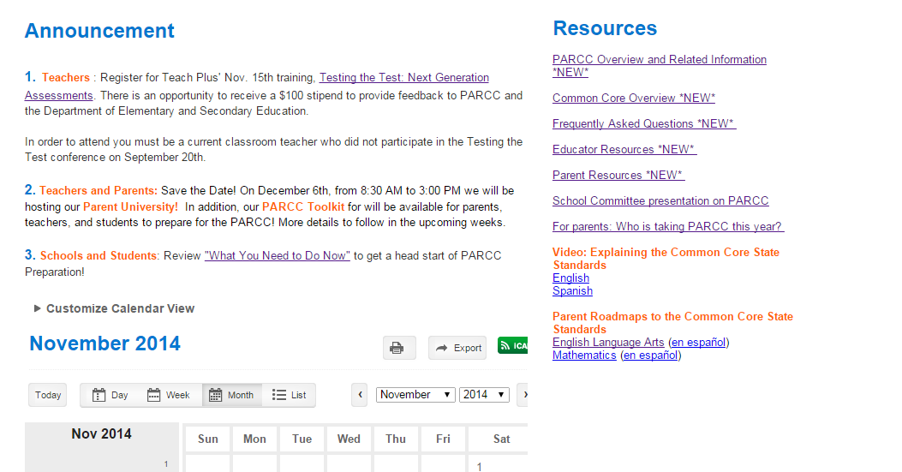
BPS Website Refresh
www.bostonpublicschools.org/parcc has been updated with relevant PARCC information. Please explore the site and provide any suggestions to parcc@bostonpublicschools.org.
Update 1: An announcement section has been added for updates and communication
Update 2: Quick links and resources have been added
Update 3: A calendar has been added for events and future releases

Slide 18
Agenda
PD Topics by Month
“What You Need to Do Now”
DESE Survey Highlights
BPS.org refresh (FAQ availability, resources, etc.)
PARCC Contact List Availability
PARCC Support Model
Available Resources and Future Plans
Survey Request and Q&A

Slide 19
PARCC Contact List Availability
We have complied a list of schools who have taken the field test in the 2013-2014 school year. Network Superintendents have this list.
When necessary, please contact a school in your Network for any advice/suggestions. If possible, please coordinate a group Q&A to be mindful of time.

Slide 20
Agenda
PD Topics by Month
“What You Need to Do Now”
DESE Survey Highlights
BPS.org refresh (FAQ availability, resources, etc.)
PARCC Contact List Availability
PARCC Support Model
Available Resources and Future Plans
Survey Request and Q&A

Slide 21
PARCC Support Model
Below depicts the support model. As information flows down, questions and support should flow back up in the same direction .This will help alleviate the attention required for each group.
Request: Please use this form to ask any questions. This will help us provide a comprehensive and updated FAQs. In addition, the BPS PARCC site will also house this QA form.
Central Office
DNA
DNA
DNA
DNA
DNA
DNA
DNA
DNAs
Principals
Teachers
Parents
Note: Parents will receive communications from all groups

Slide 22
PARCC Instruction and Assessment Team: Contacts
Name | Role | Department
Melissa Dodd | Chief of Staff | Office of Superintendent
Kamal Chavda | Chief of Data and Accountability | Office of Data & Accountability
Mark Racine | Chief Information Officer | Office of Instructional and Information Technology
Eileen de los Reyes | Chief of Academics | Office of Academics
Margarita Ruiz | Network Superintendent | Office of Academics – Network A
Kavita Venkatesh | Executive Director | Office of Academics - Instructional R&D
Long Nguyen | Education Pioneer Fellow | Office of the Superintendent

Slide 23
Agenda
PD Topics by Month
“What You Need to Do Now”
DESE Survey Highlights
BPS.org refresh (FAQ availability, resources, etc.)
PARCC Contact List Availability
PARCC Support Model
Available Resources and Future Plans
Q&A

Slide 24
Available Resources and Future Plans
Available Resources
Bostonpublicschools.org/PARCC
PARCConline.org (especially the sample questions and practice tests)
Future Plans
BPS.org/PARCC will soon house PD materials! Check back frequently for updates
Interviews with 2013-2014 PARCC schools will be added to BPS.org/PARCC. Interviews contain best practices, lessons learned, and additional PARCC related Q&As
PARCC Town Halls coming to a school near you! Logistics and details to follow
Save the Date! Parent University and the PARCC Family Toolkit will be available on December 6th, 2014. Parent University will be held at Northeastern

Slide 25
Accessibility Features and Accommodations
Many accommodations on MCAS will soon be built into computer-based PARCC tests and will be available to all students as “accessibility features.”
Use of keyboard, audio amplification, highlighter, magnification, spell checker, text-to-speech (Math), and many others
Other accommodations will be available only to students with disabilities and English language learners.
Most Massachusetts accommodations have been adopted by PARCC, including Nonstandard Accommodations.
Regional training is planned, and video tutorials are being developed, for use prior to the field test.
* Fill out document with all students and accommodations
Limitation of the assessments supersedes the IEP accommodations

Slide 26
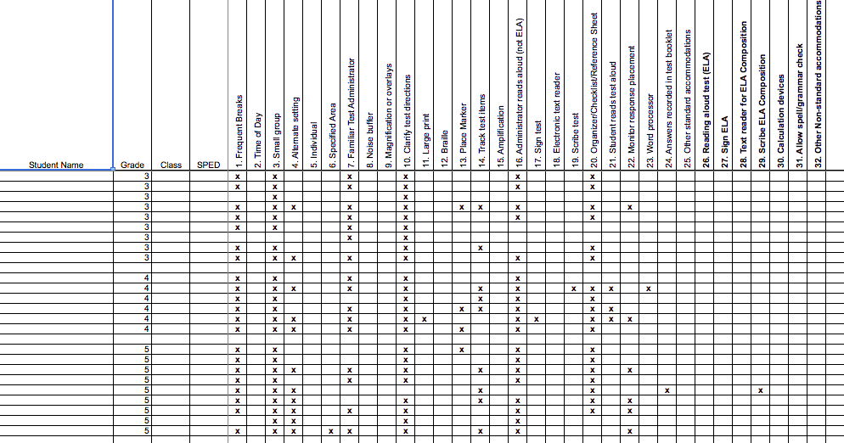
Accessibility Features and Accommodations: Template

Slide 27
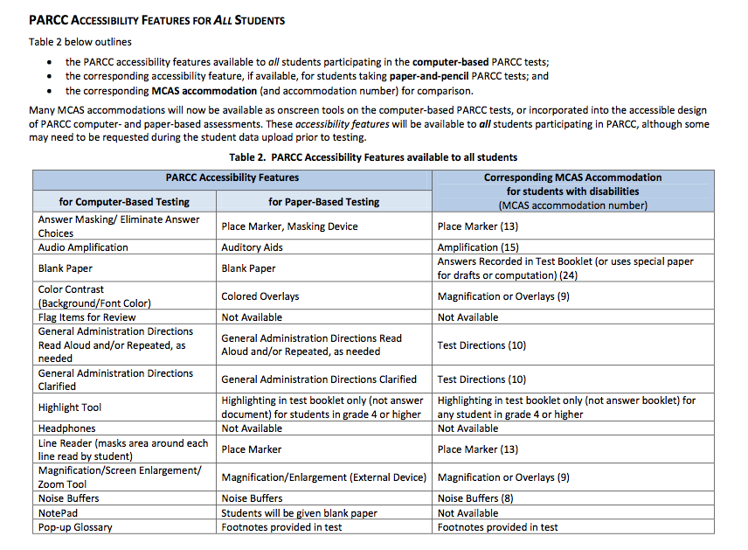
Please visit this PDF for more guidance and information from the state:
www.doe.mass.edu/parcc/Accessibility-Accommodations.pdf

Slide 28
What about time on testing?
MCAS | PARCC
Each session has a recommended duration | Each session has a designated duration
However, all sessions are untimed and students may use as much time as they like. Most schools give students until the end of the school day. | All students may use up to 50% additional time beyond the designated duration. Students with disabilities will receive the extended time accommodation as stipulated in their 504s and IEPs. ELLs are also eligible.

Slide 29
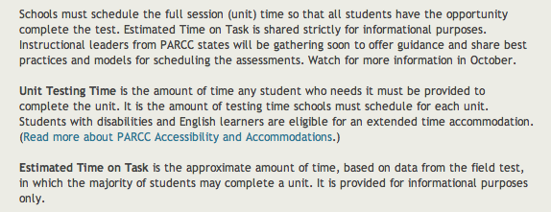
http://www.parcconline.org/update-session-times

Slide 30
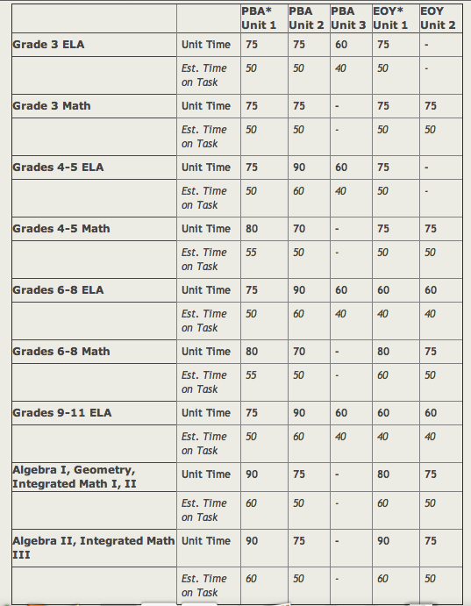

Slide 31
High School ELA & Math Sample
Resources are available online, but we have printed out a math and an ELA copy for you to review so you are able to see what the type of work our students will be expected to do in high school.

Slide 32
What can I do right now?
Instruction should reference the shifts
Instruction should reference the major work of the grade, as indicated on scope and sequence plans
Writing is critical
Have teachers review the questions available on PARCC website (we have resources for doing this)
Incorporate technology in your practice as much as possible
Not just “final product” in writing
Websites that align with instruction
Getting students on to computer
All our students have BPS Google Accounts
In December, we will go deeper into the text structures and question

Slide 33
Agenda
PD Topics by Month
“What You Need to Do Now”
DESE Survey Highlights
BPS.org refresh (FAQ availability, resources, etc.)
PARCC Contact List Availability
PARCC Support Model
Available Resources and Future Plans
Q&A

Slide 34
Questions?
?

